Slide 1
Introduction
Asadullah Hill Galib
2015
2016
2017
2018
2019
2020
2021
2022
2023
2024
Bachelors in Software Engineering
University of Dhaka
Masters in Software Engineering
Academic
University of Dhaka
PhD in Computer Science (ML)
Michigan State University
Professional
Software
Engineer
Researcher
Brain Station
23 Ltd.
FDL by NASA and SETI Ins.
Software Engineering
Key Area
Machine Learning Research
Deep Learning, Forecasting, Generative Modeling, Interpretable/Explainable AI, Representation Learning, Time Series and Spatiotemporal Modeling, Adversarial ML

Slide 2

Predictive and Generative Modeling of Extremes in Time Series using Deep Neural Networks
Asadullah Hill Galib
Advisor: Dr. Pang-Ning Tan

Slide 3
Overview
Introduction
Research Contributions
Proposed Approaches
Publications

Slide 4

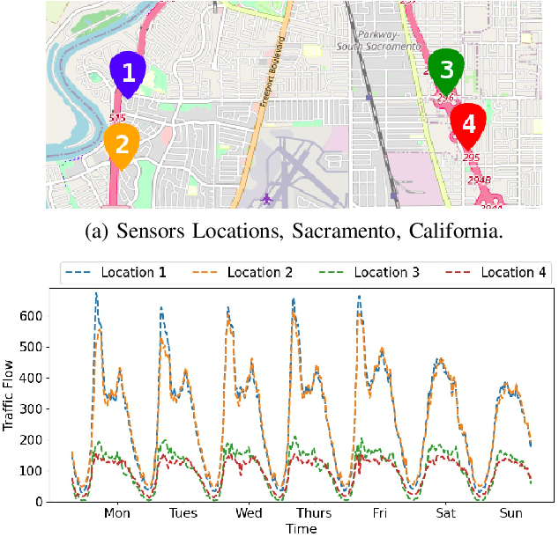
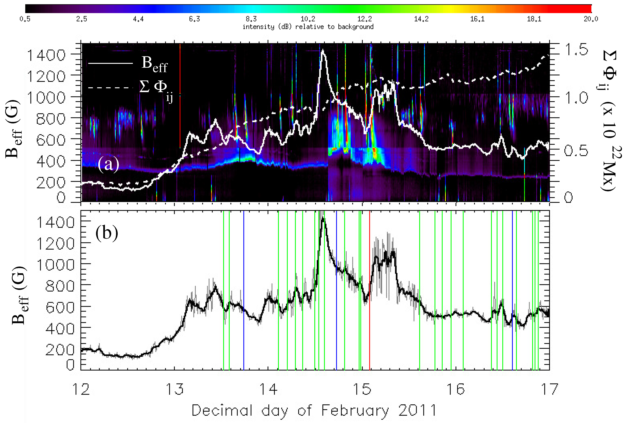
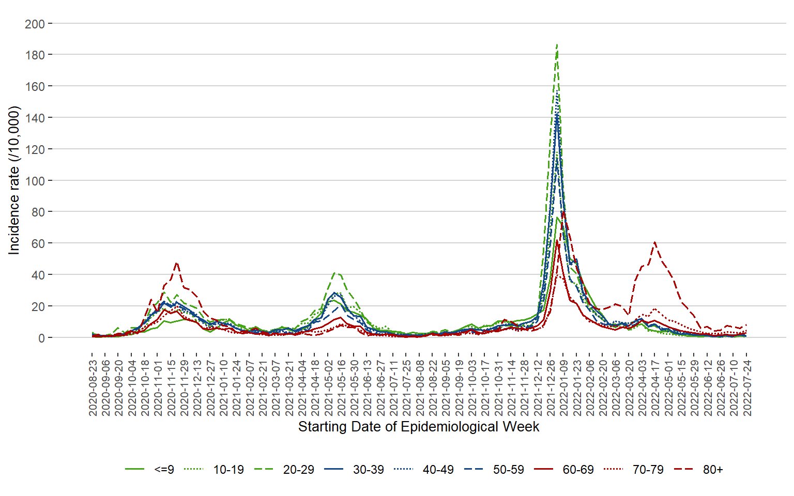
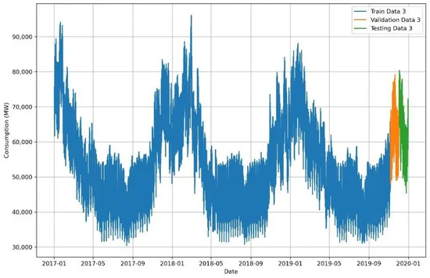
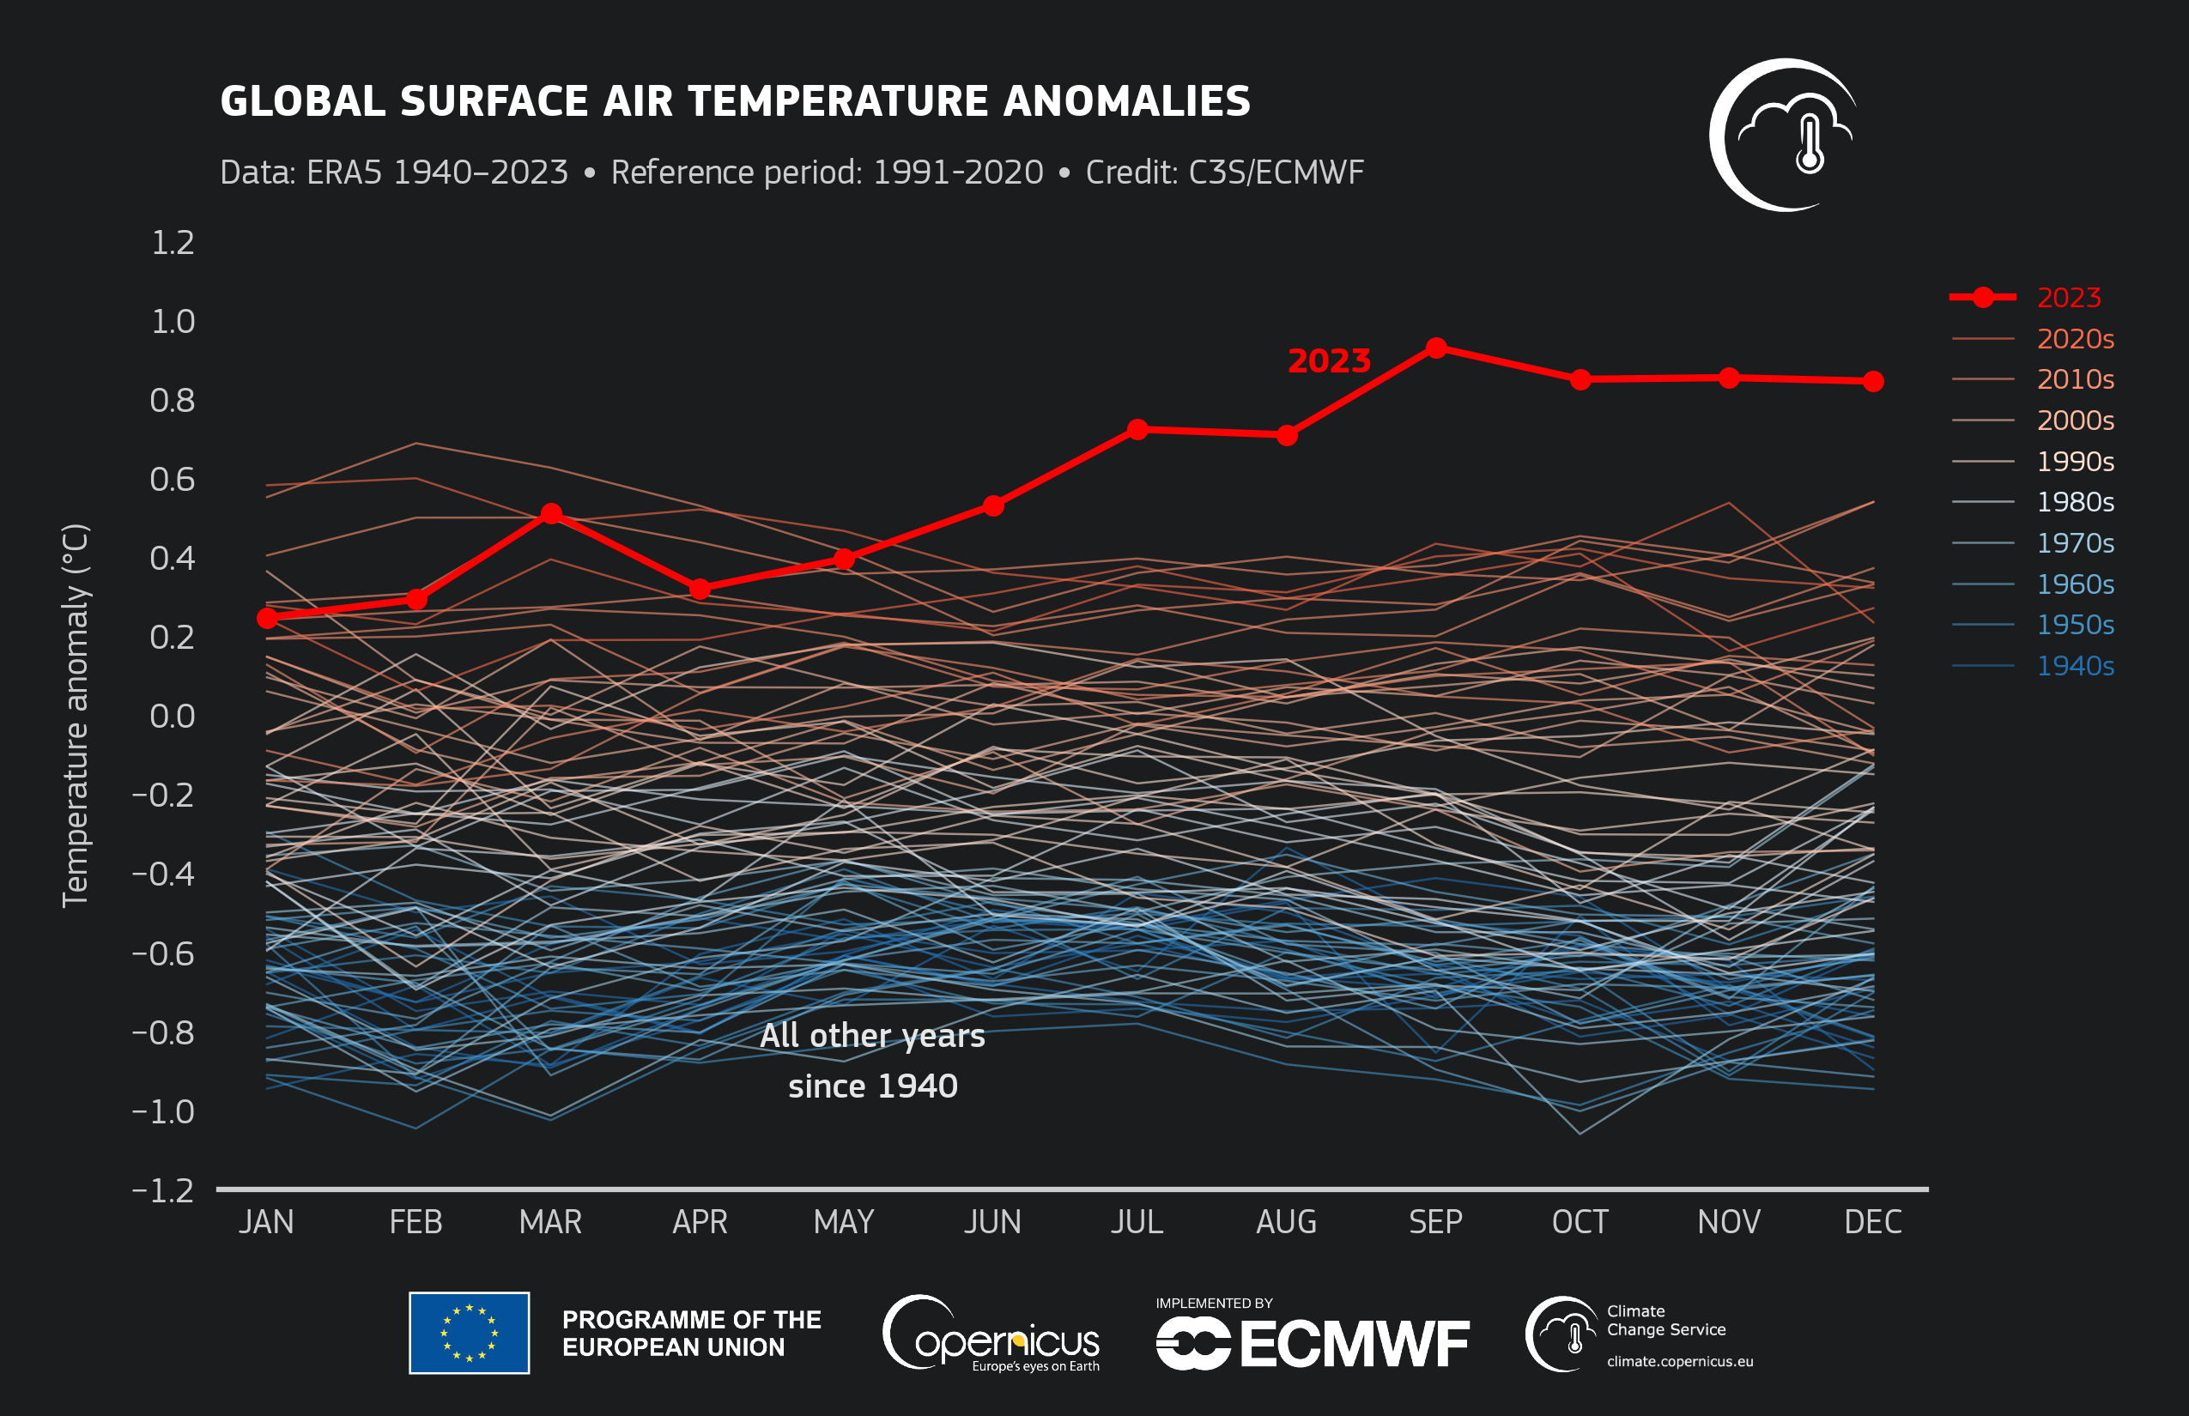
Time Series Data
Stock Market
Traffic
Solar Flare
Disease Outbreak
Energy Usage
Climate

Slide 5
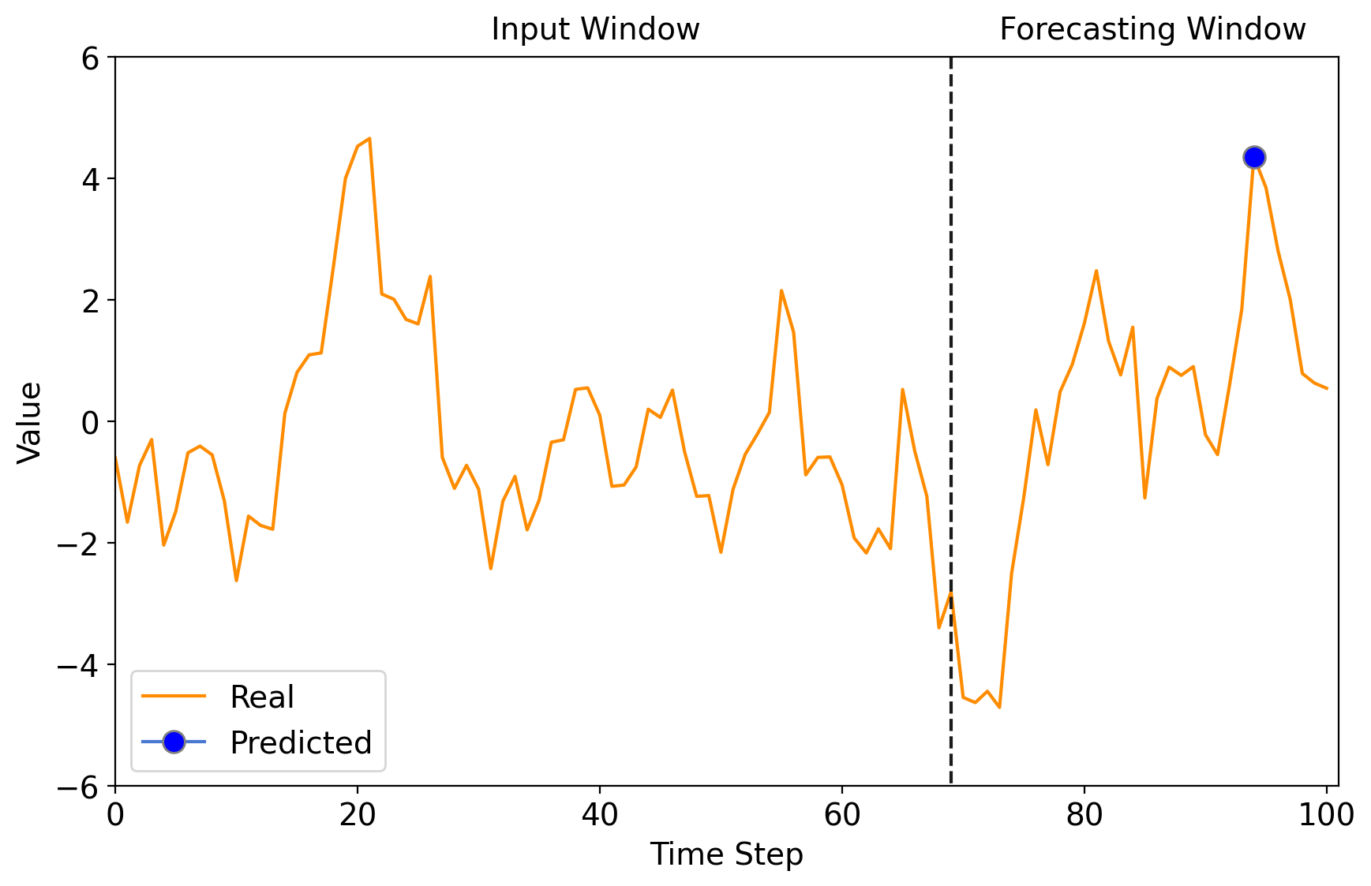
Time Series Forecasting of Extreme Values
Block Maxima

Slide 6


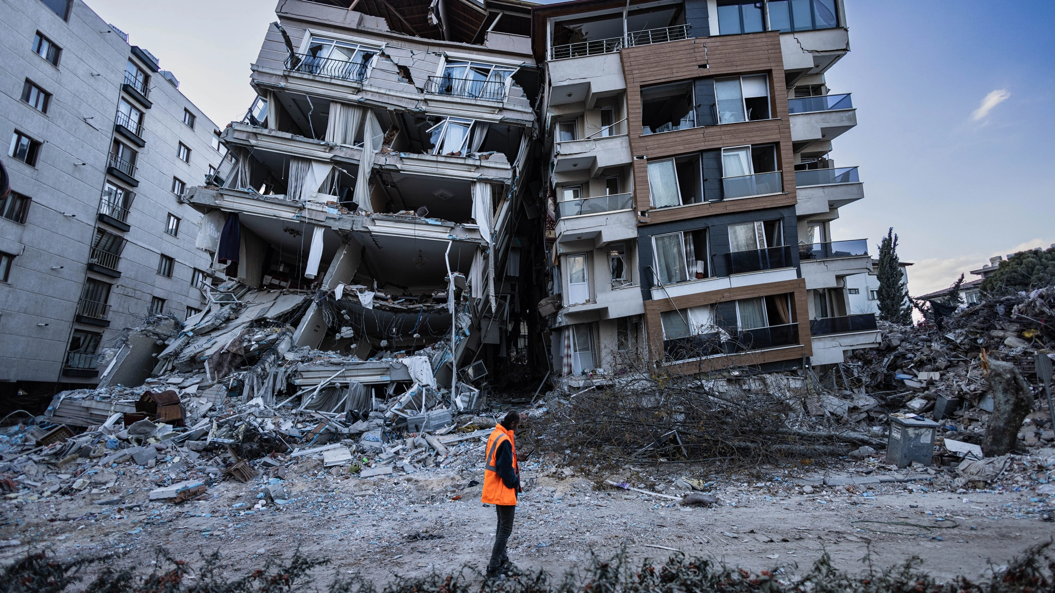
Application of Block Maxima Modeling
Maximum intensity of hurricane affects extreme storm surge and flooding
Extreme Temperature affects health, environment, energy, etc.
Amplitude of seismic waves determines
energy released by the earthquake

Slide 7
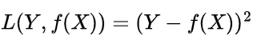
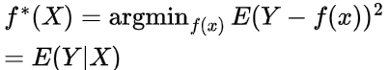
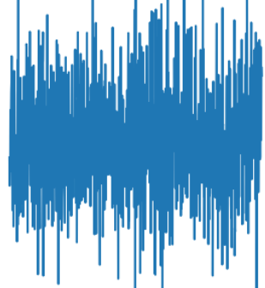
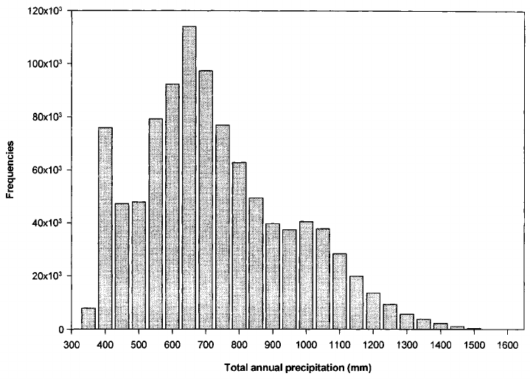
Challenges of Modeling Block Maxima
Existing models tend to predict the conditional mean rather than its extreme values
Issues with real-world data:
Noisy
Missing values
Heterogeneity
Histogram of the annual precipitation
Source: Ninyerola et al. , A Methodological approach of climatological modelling of air temperature and precipitation through GIS techniques

Slide 8
Overview
Introduction
Research Contributions
Proposed Approaches
Publications

Slide 9
Research Contributions
Modeling Extremes
My Contributions
Novelty
Extreme Value Theory
Forecasting
DeepExtrema
Model Bias Offset
IJCAI’22
Uncertainty Estimation
Hybrid Self-supervised Learning
Self-Recover
Wavelet-based Data Augmentation
IJCAI’23
Imputation
SimEXT
Tail-weighted Distribution Loss
ICDM’23
High Frequency Components Inflation
Representation Learning
DiffMaxima
GEV Distribution Enforcement
Under Submission
Generation
DEMM
Conditional Generative Modeling
KDD’22
Mixture Model Constraint Enforcement
DiffusionCF
GPD Constraint Enforcement
Explainability
Under Submission
Counterfactual Explanation

Slide 10
Overview
Introduction
Research Contributions
Proposed Approaches
DeepExtrema: A Deep Learning Approach for Forecasting Block Maxima in Time Series Data
DiffMaxima: Conditional Diffusion Model for Generating Time Series with Extreme Events
Publications

Slide 11
Deep Learning for Block Maxima Forecasting
Motivation:
Traditional deep learning are biased towards modeling conditional mean.
Need for estimating forecast uncertainty
Proposed strategy: Use Extreme value theory (EVT) to learn the tail distribution of the time series and to provide uncertainty estimation
Challenge: How to integrate EVT into deep learning formulation?
Histogram of the annual precipitation
Source: Ninyerola et al. , A Methodological approach of climatological modelling of air temperature and precipitation through GIS techniques
Notes:
Traditional deep learning methods are biased towards modeling the conditional mean.
Many applications require estimation of the model forecast uncertainty for risk assessment and planning.

Slide 12
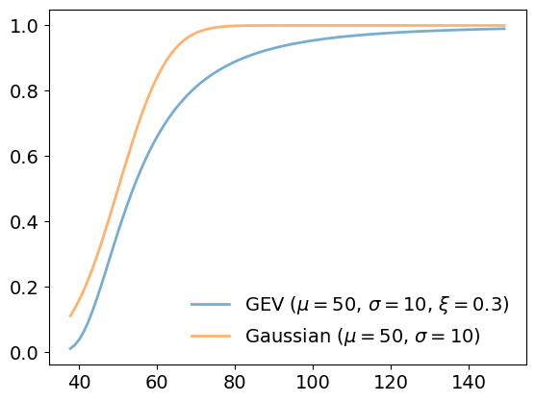
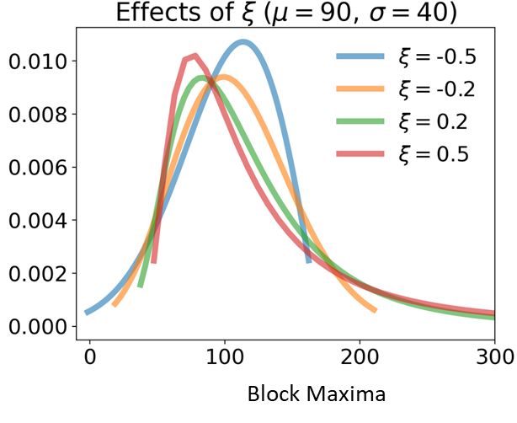
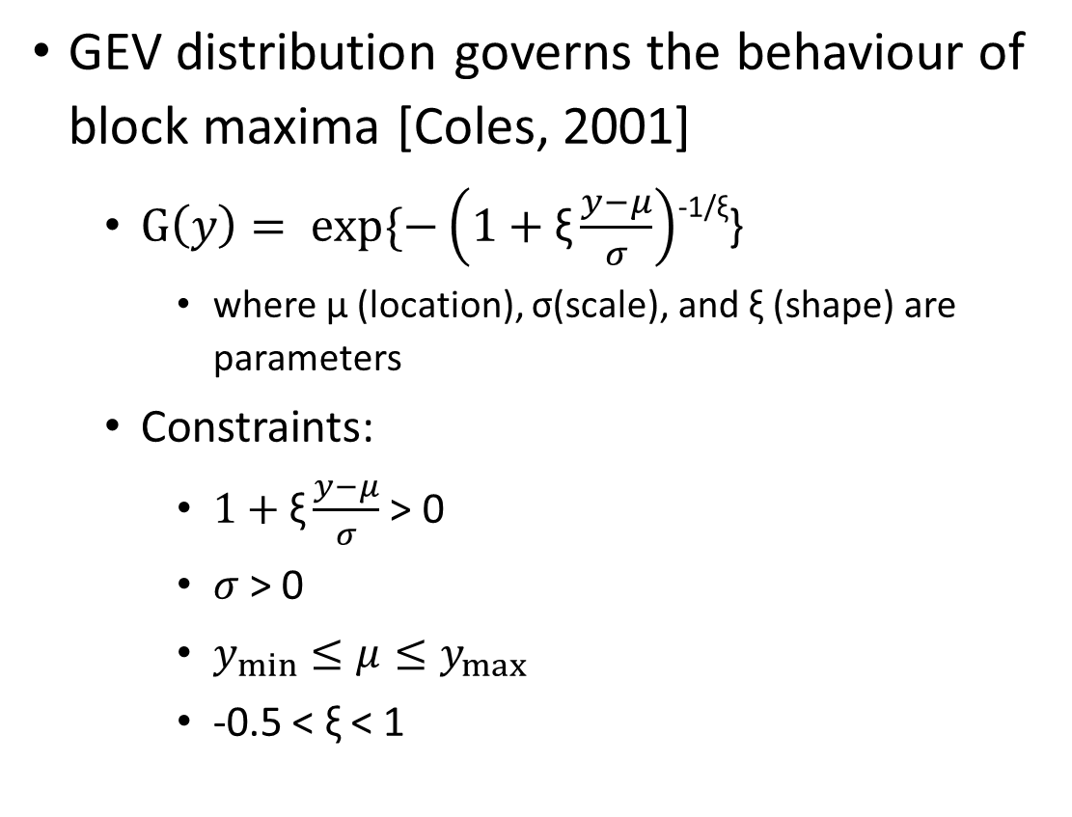
Generalized Extreme Value (GEV) Distribution
CDF of GEV and Gaussian distribution
GEV distribution governs the behaviour of block maxima [Coles, 2001]
$G\left(y\right)= exp\{−\left(1+\text{ξ}\frac{y−μ}{σ}\right)$^{-1/ξ}}
where μ (location), σ(scale), and ξ (shape) are parameters
Constraints:
$1+\text{ξ}\frac{y−μ}{σ}$ > 0
$σ$> 0
$y_{min}≤μ≤y_{max}$
-0.5 < $\text{ξ}$ < 1
Positivity
Regularity
Notes:
Merge 1,2,3,5 bullets
4 at last

Slide 13
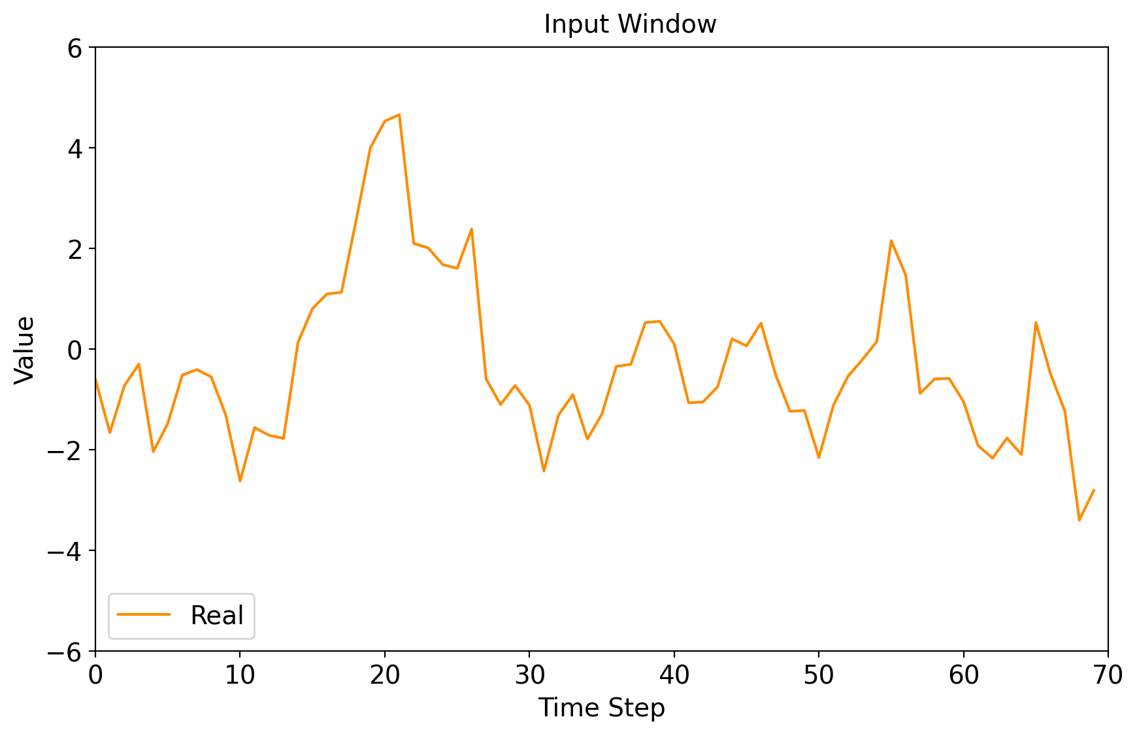
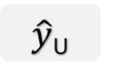
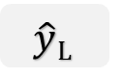
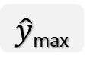
Integrating EVT into Deep Learning
Extreme Value Theory
Block maxima
Prediction
How to train the deep neural network to accurately infer the GEV parameters while maintaining the constraints?
How to use the estimated parameters to generate the forecasts and its uncertainty?
GEV Parameter Estimation
$\hat{y}$_{max}
Representation Learning
μ
σ
ξ
Forecasting Model
$$\hat{y}L$$
Uncertainty Estimations (Confidence Interval)
$\hat{y}$_{U}
Deep Neural Networks
Historical Observation
Method
Goal

Slide 14
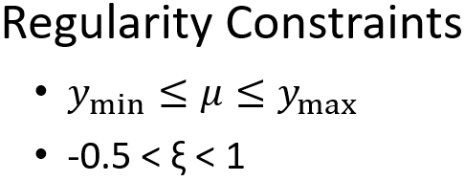
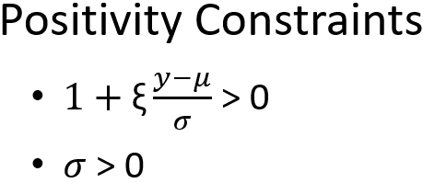
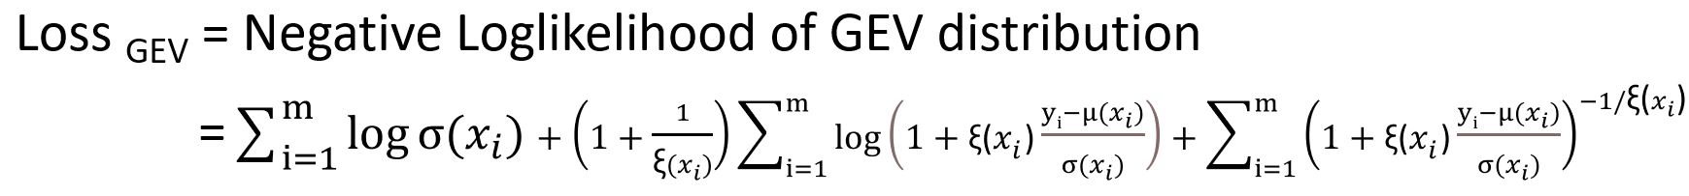
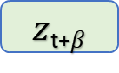
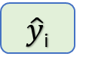
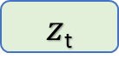
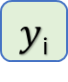
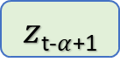
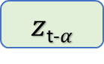
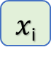
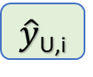
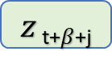
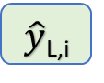
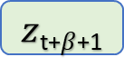
DeepExtrema: Overall Framework
GEV Parameter Estimation
Block Maxima Prediction
Predicted upper and lower quantile
Constraint
Enforcement
Model Bias Offset
Uncertainty Estimation
$\hat{y}$_{L,i}
$\hat{y}$_{U,i}
μ_{0,i}
μ_{i}
Quantile Calculation
$z$_{t-}$α$
LSTM Layer 1
LSTM Layer k
FCN
P_{1,i}
Softplus
σ_{i}
Historical Observation
$z$_{t-}$α$₊₁
$x$_{i}
FCN
P_{2,i}
ξ_{u,i}
$z$_{t}
P_{3,i}
ξ_{l,i}
$z$_{t+}$β$
GEV Loss
Predicted block maxima
$\hat{y}$_{i}
Block Maxima
$z$_{t+}$β$₊₁
$y$_{i}
RMSE Loss
$z$ _{t+}$β$_{+j}

Slide 15
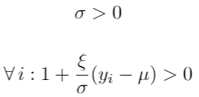
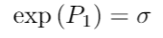
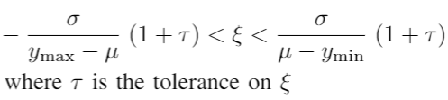
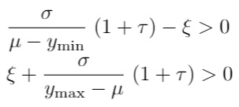
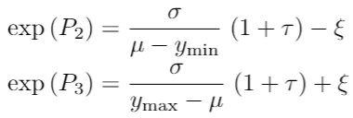
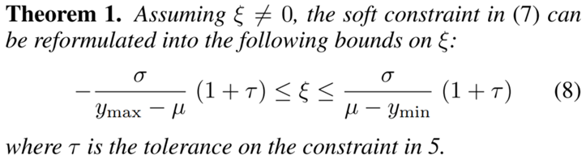
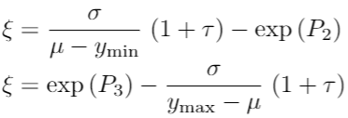
Constraint Enforcement
Constraints Reparameterization
GEV Constraints
Constraint Enforcement
Constraint Reformulation

Slide 16
Model Bias Offset
Model
μ₀
μ_{bias} = μ₀ - μ_{desired}
σ_{bias} = σ₀ - σ_{desired}
ξ _{u, bias} = ξ_{u, 0} - ξ _{u, desired}
ξ _{l, bias} = ξ_{l, 0} - ξ _{l, desired}
1st iteration (backpropagation disabled)
σ₀
X₀
ξ_{u, 0}
ξ_{l, 0}
Subsequent iterations (backpropagation enabled)
Model
μ_{t}
μ_{t} - μ_{bias}
σ_{t}
σ_{t} - σ _{bias}
Bias
Correction
X_{t}
ξ_{u, t}
ξ_{u, t} - ξ_{u, bias}
ξ_{l, t}
ξ_{l, t} - ξ _{l, bias}

Slide 17
Experimental Evaluation
Research Questions
RQ1: Can we accurately estimate the parameters of the GEV distribution from the input data using deep learning?
RQ2: Does the incorporation of GEV distribution improve the performance of forecasting extreme values?
Datasets
Synthetic: generated assuming the GEV parameters are given
Real world:
Hurricane (forecasting maximum wind speed for a 2-day window)
Ausgrid (predicting maximum energy usage for a 48-hour window)
Weather (forecasting maximum temperature for an 8-hour window)

Slide 18
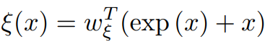
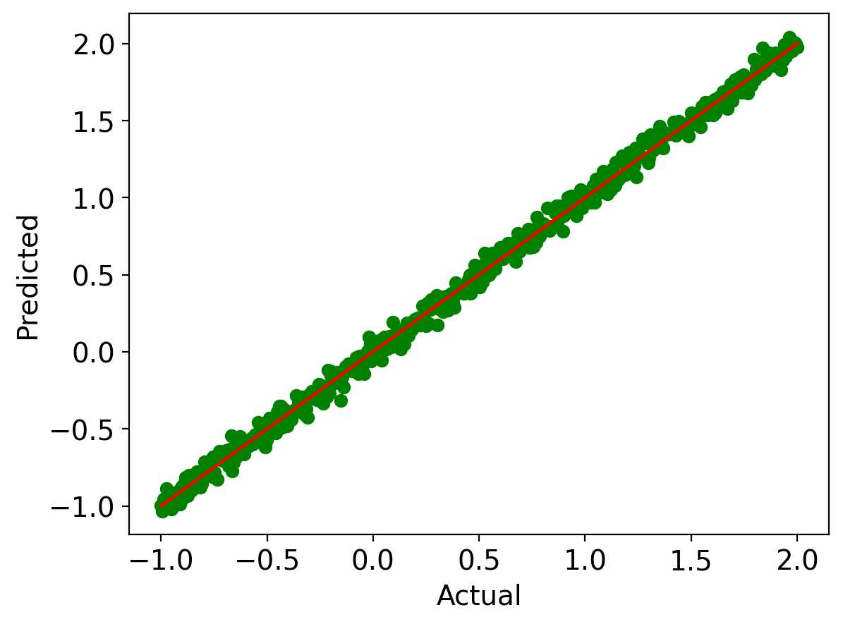
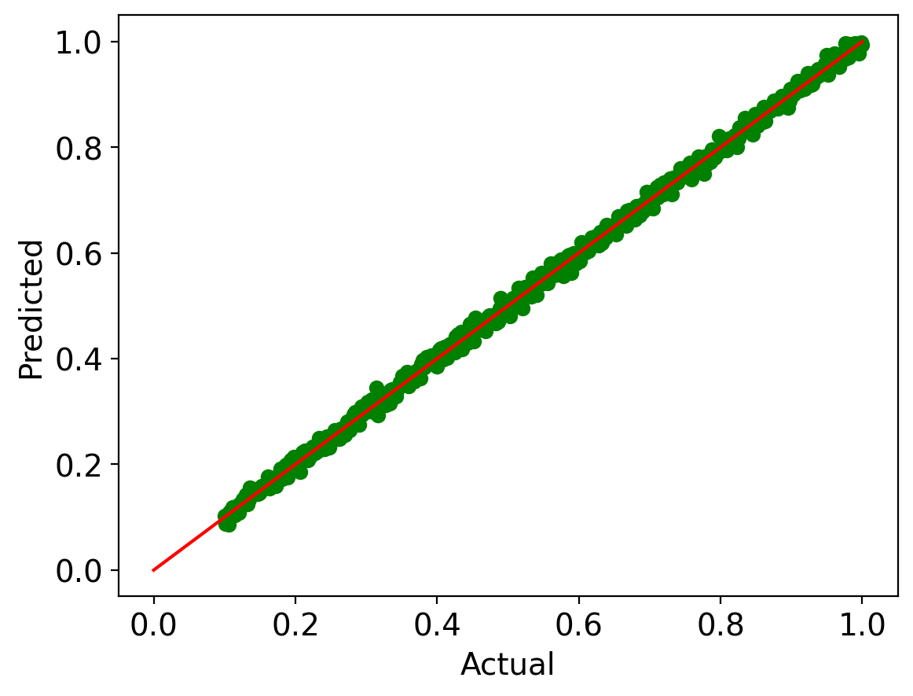
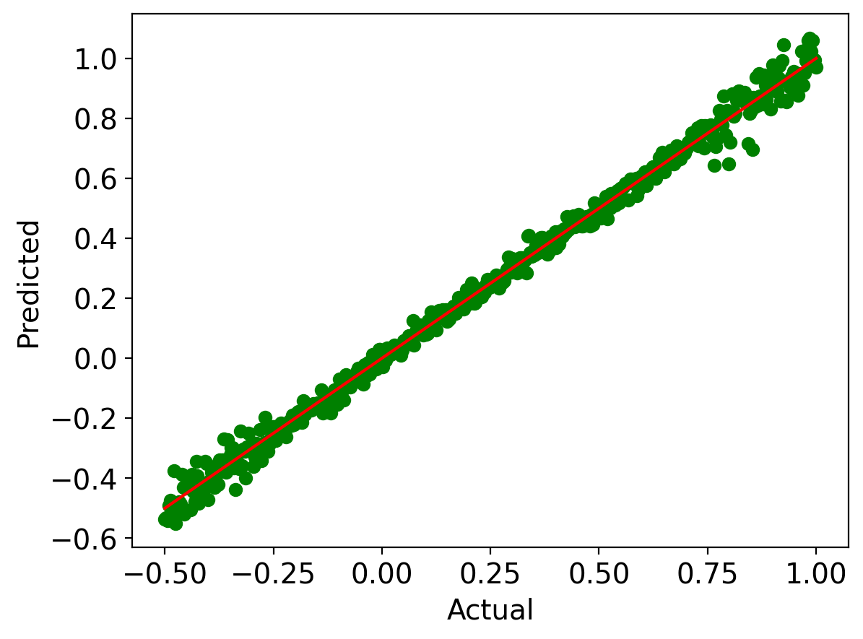
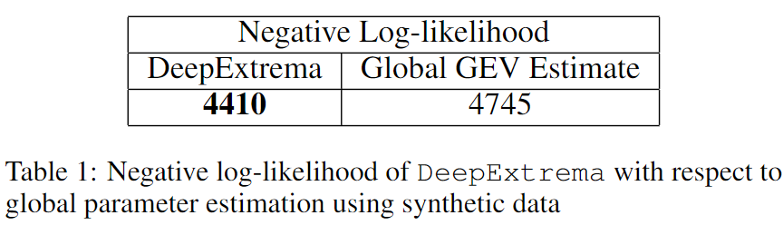
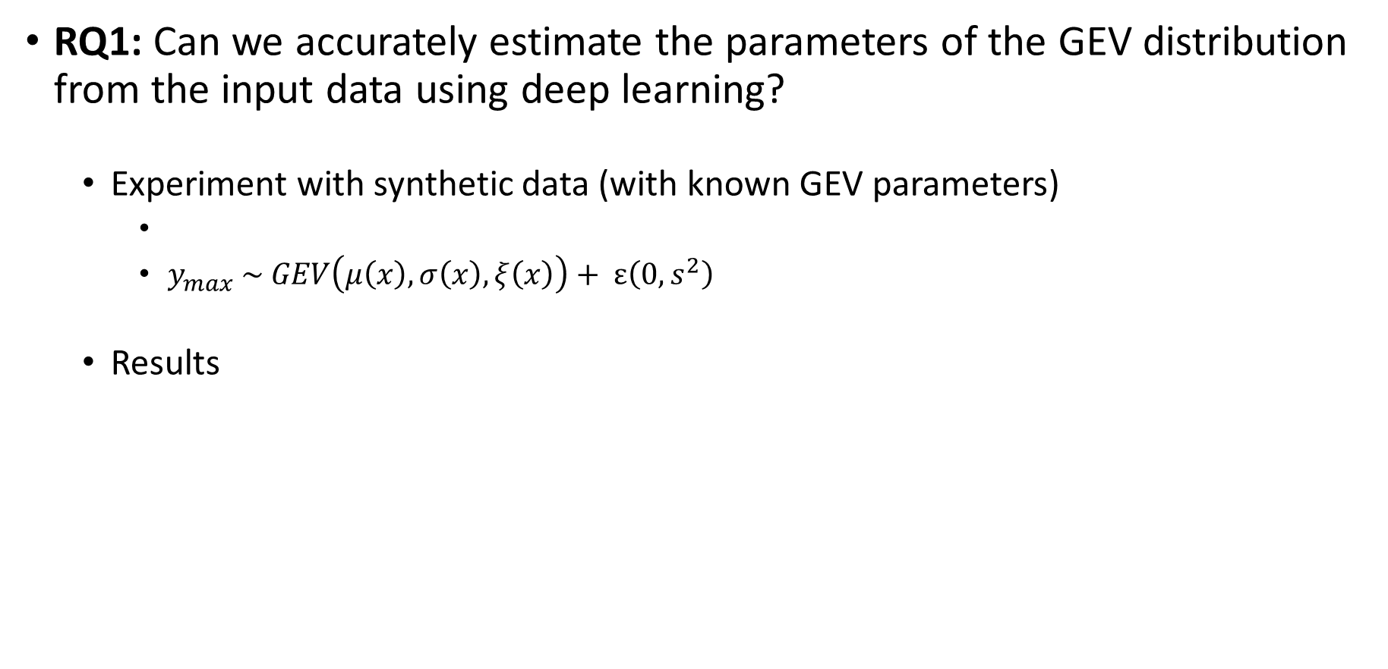
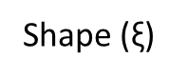
Experimental Evaluation
RQ1: Can we accurately estimate the parameters of the GEV distribution from the input data using deep learning?
Experiment with synthetic data (with known GEV parameters)
$y_{max} \sim GEV\left(μ\left(x\right),σ\left(x\right),ξ\left(x\right)\right)+ ε\left(0, s^{2}\right)$
Results
Location (μ)
Scale (σ)
Shape ($\text{ξ}$)
Notes:
Data gene
Add histogram
Remove ground truth from the table

Slide 19
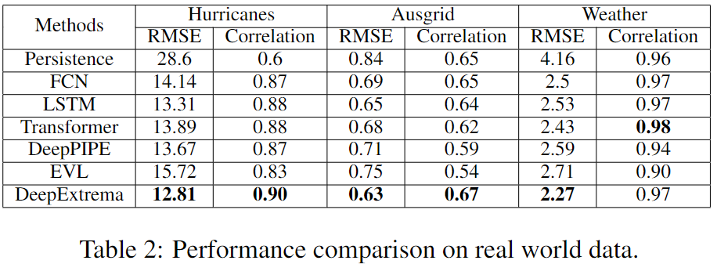
Experimental Evaluation
RQ2: Does the incorporation of GEV distribution improve the performance of forecasting extreme values?
DeepExtrema outperforms the baseline methods

Slide 20
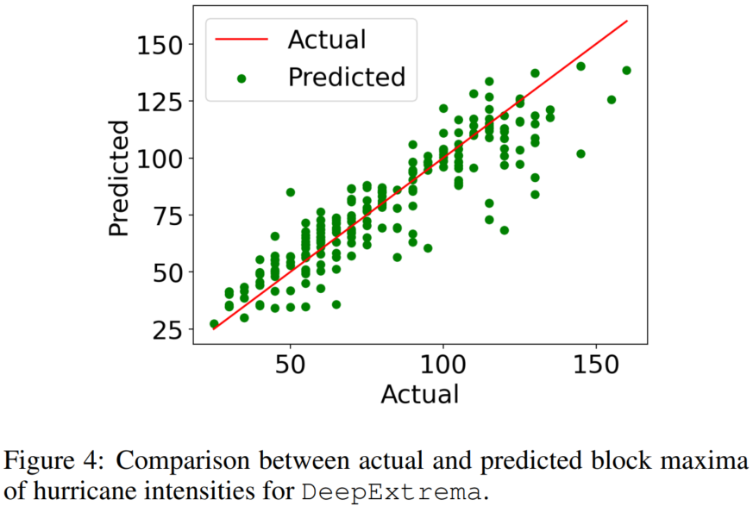
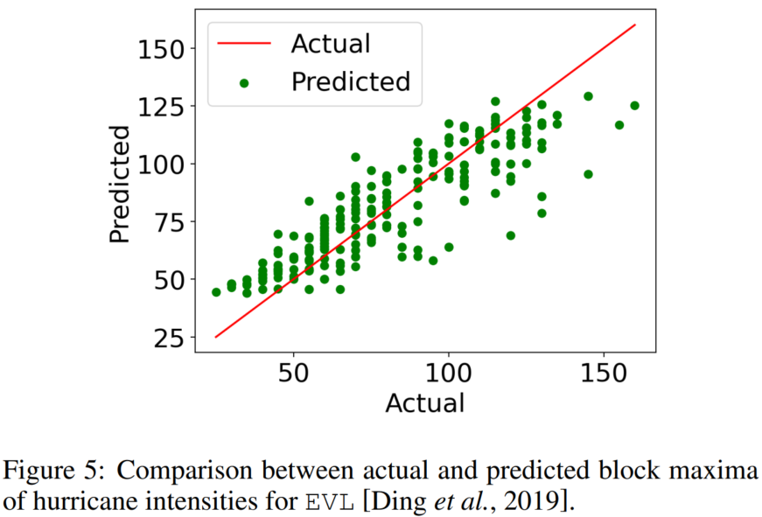
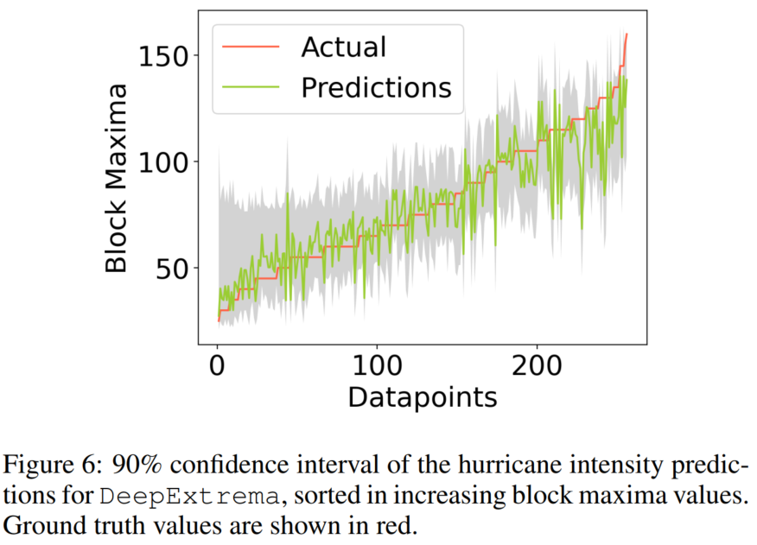
Experimental Evaluation
Notes:
Hide quantile part first

Slide 21






Case Study: Maximum Hurricane Intensity Prediction
$152.2 Billion
$500 Million
Source: Bloomberg; The New York Times
Source: NBC News
Notes:
Accurately forecasting extremes in time series is a complex and challenging task that demands specialized models and approaches, as advanced models like Transformer-based models struggle to predict extreme values with high accuracy. The difficulty of forecasting extremes is emphasized by Figure \ref{fig:intro_research_challenge}, which illustrates the limitations of existing models and techniques in predicting extreme events. The figure illustrates the results of three different settings for time series forecasting using a Transformer-based model. The top row shows the performance of sequence-to-sequence forecasting, which does not perform well considering all values in the forecasting window, particularly for extreme values, as shown by the Kernel Density Estimation plots. The middle row depicts the results of sequence-to-sequence forecasting, where the model predicts all time steps in the forecasting window but only uses block maxima for optimization and evaluation. It also fails to perform well for extreme values. The bottom row shows the model's performance when directly predicting block maxima in the forecasting window, which is an improvement over the previous settings, but it still falls short of the ground truth distribution. This suggests that forecasting extreme events requires more complex and specialized models or approaches.
Make animation

Slide 22


Case Study: Maximum Hurricane Intensity Prediction
Major Hurricane: Harvey (2017)
Hurricane: Ernesto (2012)
Notes:
Accurately forecasting extremes in time series is a complex and challenging task that demands specialized models and approaches, as advanced models like Transformer-based models struggle to predict extreme values with high accuracy. The difficulty of forecasting extremes is emphasized by Figure \ref{fig:intro_research_challenge}, which illustrates the limitations of existing models and techniques in predicting extreme events. The figure illustrates the results of three different settings for time series forecasting using a Transformer-based model. The top row shows the performance of sequence-to-sequence forecasting, which does not perform well considering all values in the forecasting window, particularly for extreme values, as shown by the Kernel Density Estimation plots. The middle row depicts the results of sequence-to-sequence forecasting, where the model predicts all time steps in the forecasting window but only uses block maxima for optimization and evaluation. It also fails to perform well for extreme values. The bottom row shows the model's performance when directly predicting block maxima in the forecasting window, which is an improvement over the previous settings, but it still falls short of the ground truth distribution. This suggests that forecasting extreme events requires more complex and specialized models or approaches.
Make animation

Slide 23
Summary
Propose a framework called DeepExtrema that combines EVT and deep learning for block maxima prediction in time series
Novel GEV constraint enforcement technique
Provides point and quantile estimations along with estimated GEV parameters
Results on real-world datasets show DeepExtrema outperformed other baseline methods (including Transformer, EVL, and DeepPIPE)

Slide 24
Overview
Introduction
Research Contributions
Proposed Approaches
DeepExtrema: A Deep Learning Approach for Forecasting Block Maxima in Time Series Data
DiffMaxima: Conditional Diffusion Model for Generating Time Series with Extreme Events
Future Work
Publications

Slide 25



















Deep Generative Models
Generative Adversarial Networks (GAN)
Variational Autoencoders (VAE)
Normalizing Flow
Diffusion Model
Diffusion Model (DDPM)
Forward Process
$$q(x^{n}|x^{n−1})$$
$$p(x^{n}|x^{n−1})$$
$$q(x^{n−1}|x^{n})$$
$$x^{0}$$
$$x^{1}$$
$$x^{n−1}$$
$$x^{n}$$
$$x^{N}$$
$$\sim Ν\left(0,I\right)$$
Reverse Process Network
$$ε_{θ}\left(x^{n}\right)$$
Loss =
$${\left\|ε−ε_{θ}\right\|}^{2}$$
Training
$$x^{N}$$
$$\sim Ν\left(0,I\right)$$
$$x^{n}$$
$$x^{1}$$
$$x^{0}$$
Sampling
$$ε_{θ}\left(x^{n}\right)$$
Sampling
25

Slide 26

Motivation
Goal: to generate realistic looking time series that preserves block maxima distribution
Comparing the distributions of all values and block maxima values for real and generated samples using DDPM when applied to the synthetic AR(2) data

Slide 27

Diffusion Model: From Data to Noise
Diffusion Model for Time Series Modeling
Determining Time Series Transition to Noise
p-value
Original: 0.05
Perturbed: 0.64
Shapiro–Wilk
Normality test

Slide 28


Generative Modeling for Block Maxima
Key Observations:
Block maxima correlate strongly with high-frequency data components
Diffusion model’s noise addition diminishes block maxima faster before the model can learn their distribution

Slide 29


High-frequency Inflation
Strategy
Effect
After Inflating
High-frequency

Slide 30
Proposed Strategy
Introduce a high-frequency inflation strategy within the frequency domain to ensure sustained emphasis on local patterns, preventing their premature fade-out
Expand unconditional diffusion models for generating conditional samples based on block maxima
Incorporate GEV distribution to emphasis block maxima alongside overall data distribution, supported by theoretical basis

Slide 31









DiffMaxima: Training

Slide 32










DiffMaxima: Sampling
Sampling using Conditional Reverse Process Network
$${\hat{x}}_{N}$$
$$\sim Ν\left(0,I\right)$$
$${\hat{x}}_{n}$$
$${\hat{x}}_{n−1}$$
$${\hat{x}}_{1}$$
$${\hat{x}}_{0}$$
Reverse Process Network
$$ε_{θ}\left({\hat{x}}_{n}, n,{\hat{y}}_{0} \right)$$
$${\hat{y}}_{0}$$
μ
Fitted GEV distribution
using all block maxima
σ
$$θ_{gev}$$
Sampling block maxima
ξ

Slide 33
Experimental Evaluation
Research Questions
RQ1: How well the distribution of generated data matches with the original data?
RQ2: How well the generative model accurately replicate the temporal characteristics of the original data for predictive modeling task?
Datasets
AR2: synthetic time series data using autoregressive model of order 2
Financial Data (Stocks): daily historical Google stocks data from 2004 to 2019
Energy Data (Appliance Energy): The UCI Appliances energy prediction dataset
Weather/Climate Data (Daily Minimum Temperature): daily minimum temperatures in Melbourne, Australia, from 1981 to 1990
Medical Data (ECG5000: Congestive Heart Failure): 20-hour long (5,000 heartbeats) electrocardiogram (ECG) obtained from the Physionet database

Slide 34


Experimental Evaluation (RQ1)
Generated data using DiffMaxima matches well with the true distribution of block maxima

Slide 35
Experimental Evaluation (RQ2)
Block Maxima
Predictive
Task
Trained on
Generated Data
Tested on
Original Data
Predictive Score = RMSE on Original Data
(Yoon et al., 2019)
DiffMaxima accurately replicates the temporal characteristics of the original data for predictive modeling task

Slide 36

Experimental Evaluation
Ablation study highlights the indispensable role of each component in achieving optimal performance

Slide 37
Summary
DiffMaxima provides a comprehensive strategy enhancing model's capability to capture and emphasize extreme event distributions.
It addresses limitations by preserving high-frequency components and enabling conditional generation.
Integration of GEV distribution extends conventional diffusion models by emphasizing more on the block maxima distribution.
Superiority of the framework confirmed through experiments on real-world and synthetic data.

Slide 38

Future Work
Conditional Generative Modeling of spatiotemporal extremes
Applications
To simulate extreme weather conditions where training GCMs are expensive
Explainable AI for the proposed approaches
Develop post-hoc explainable AI strategy to better understand the extreme events and to bridge gap with the underlying physical processes
Klemmer et al., Generative Modeling of Spatio-temporal weather patterns with extreme event conditioning, ICLR 2021

Slide 39
Other Research Interests
Generative Modeling (Image, spatiotemporal)
Adversarial Machine Learning
Self-supervised Learning
Physics-informed Neural Network
NLP
ML Applications: Security, Software Engineering, Medical

Slide 40
Publications
* denotes equal contribution
Asadullah Hill Galib, Pang-Ning Tan, & Lifeng Luo (2024). Conditional Diffusion Model for Generating Time Series with Extreme Events. Under Submission.
Yue Deng, Asadullah Hill Galib, Pang-Ning Tan, & Lifeng Luo (2023). Unraveling Block Maxima Forecasting Models with Counterfactual Explanation. Under Submission.
Asadullah Hill Galib, Pang-Ning Tan, & Lifeng Luo (2023). SimEXT: Self-supervised Representation Learning for Extreme Values in Time Series. In Proceedings of the 23rd IEEE International Conference on Data Mining, ICDM 2023 (pp. 1031-1036), IEEE.
Asadullah Hill Galib, Andrew McDonald, Pang-Ning Tan, & Lifeng Luo (2023). Self-Recover: Forecasting Block Maxima in Time Series from Predictors with Disparate Temporal Coverage using Self-Supervised Learning. In Proceedings of the Thirty-Second International Joint Conference on Artificial Intelligence, IJCAI 2023 (pp. 3723-3731).
Asadullah Hill Galib, Andrew McDonald, Tyler Wilson, Lifeng Luo, & Pang-Ning Tan (2022). DeepExtrema: A Deep Learning Approach for Forecasting Block Maxima in Time Series Data. In Proceedings of the Thirty-First International Joint Conference on Artificial Intelligence, IJCAI 2022 (pp. 2980-2986).
Tyler Wilson, Asadullah Hill Galib, Pang-Ning Tan, & Lifeng Luo (2022). Beyond Point Prediction: Capturing Zero-Inflated & Heavy-Tailed Spatiotemporal Data with Deep Extreme Mixture Models. In Proceedings of ACM SIGKDD International Conference on Knowledge Discovery and Data Mining (KDD 2022), Washington, DC.
Tyler Wilson, Pang-Ning Tan, Lifeng Luo, and Asadullah Hill Galib (2021). Deep Learning With Extreme Value Theory for Modeling Precipitation Events. In AGU Fall Meeting Abstracts, vol. 2021, pp. A15Q-07.
Luke Cullen*, Asadullah Hill Galib*, Andrew William Smith*, Debvrat Varshney*, Edward Brown, Peter Chi, Xiangning Chu, and Filip Svoboda (2022). Can We Forecast and Detect Earthquakes From Heterogeneous Multivariate Time Series Data? In I Can’t Believe It’s Not Better Workshop: Understanding Deep Learning Through Empirical Falsification. (ICBINB@ NeurIPS 2022).
Luke Cullen*, Asadullah Hill Galib*, Andrew William Smith*, Debvrat Varshney*, Edward Brown, Peter Chi, Xiangning Chu, and Filip Svoboda (2024). A Global Analysis of Pre-Earthquake Ionospheric Anomalies. Under Submission.
Luke Cullen*, Asadullah Hill Galib*, Andrew William Smith*, Debvrat Varshney*, Edward Brown, Peter Chi, Xiangning Chu, and Filip Svoboda (2022). Open-Source Data Pipelines and Statistical Tool for Studying Pre-Seismic and Post-Seismic Disturbances in the Ionosphere and Geomagnetic Field. In AGU Fall Meeting 2022.
Luke Cullen*, Asadullah Hill Galib*, Andrew William Smith*, Debvrat Varshney*, Edward Brown, Peter Chi, Xiangning Chu, and Filip Svoboda (2022). Comprehensive Statistical Analysis of Ionospheric and Geomagnetic Signatures Before and After Earthquakes. In AGU Fall Meeting 2022.
Luke Cullen*, Asadullah Hill Galib*, Andrew William Smith*, Debvrat Varshney*, Edward Brown, Peter Chi, Xiangning Chu, and Filip Svoboda (2022). Multimodal Machine Learning for Earthquake Identification and Forecasting. In AGU Fall Meeting 2022.

Slide 41
Thank you

